Slide 1
Introduction to Decision Trees

Slide 2
Introduction
Money
We can consider Decision Tree like bunch of nested if-else statements
Spam
Earn free money by playing a game
Free money !!!! sign up here
Not Spam
Hi good morning, could we get on a quick call I have a few doubts !
yes
No
Not Spam
Free
yes
No
Spam
Not Spam

Slide 3
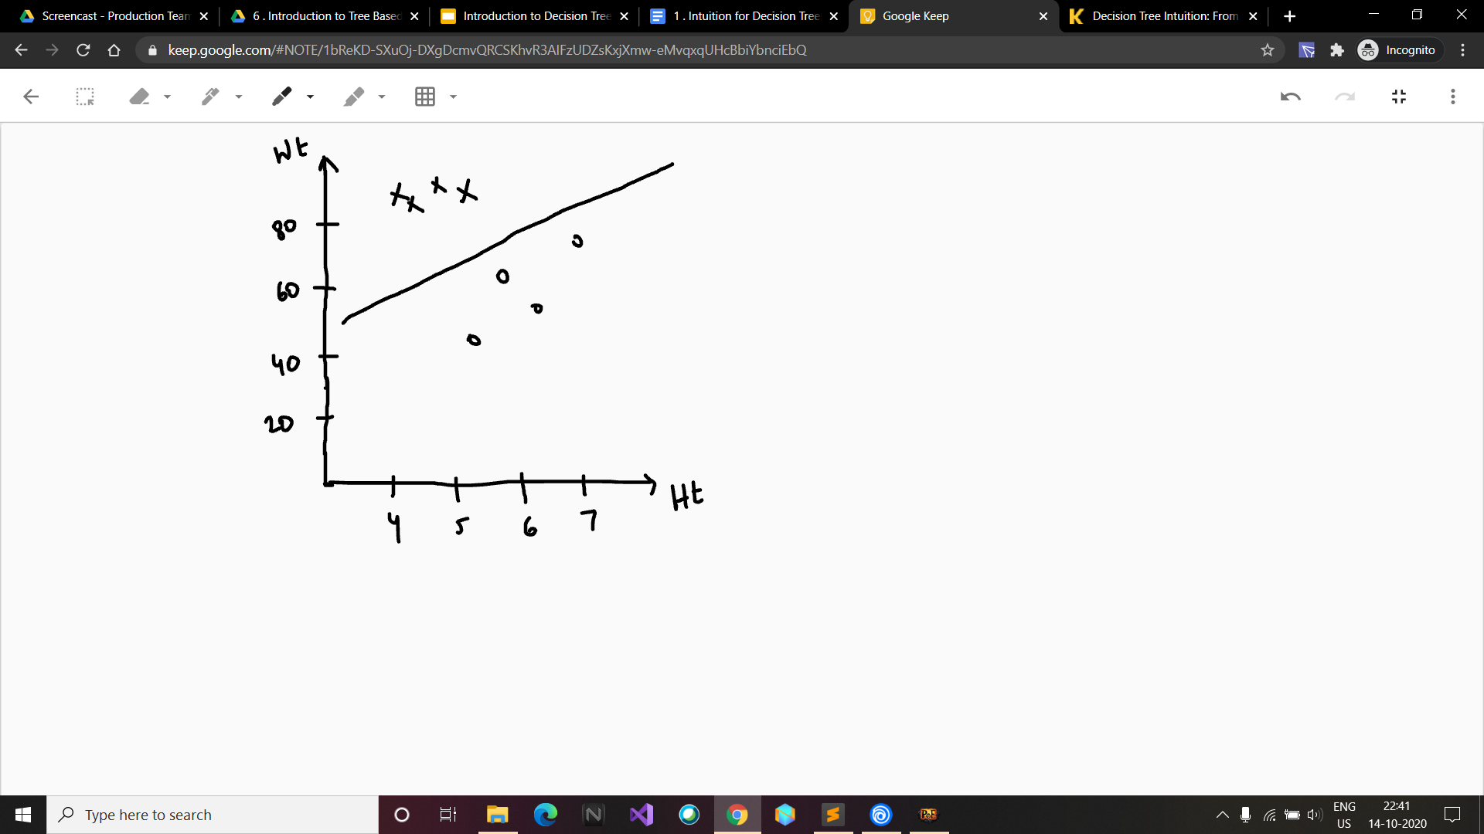
Geometry: Logistic Regression
Here we have to predict the health of a person based on their heights and weights .
Logistic Regression

Slide 4
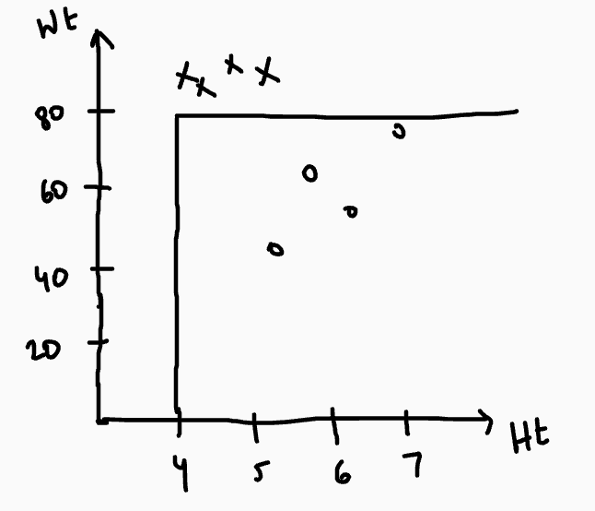
Geometry: Decision Trees
weight
Here we split on Weight = 80 and height = 4
> 80
< 80
Unhealthy
height
> 4
< 4
Healthy
Unhealthy

Slide 5
Decision Trees
Decision Trees are able to fit the complex patterns much better than the linear models .
A bunch of ‘if’ statements doesn’t sound like machine learning
what makes it machine learning is how we choose the conditions on which we want to split - Information theory

